Slide 1

Prutor The Way IIT’s Learn To Code
Course Name: Artificial Intelligence
&
Machine Learning

Slide 2

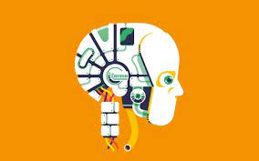
Machine Learning
Machine learning (ML) is the study of computer algorithms that can improve automatically through experience and by the use of data.It is seen as a part of artificial intelligence. Machine learning algorithms build a model based on sample data, known as "training data", in order to make predictions or decisions without being explicitly programmed to do so. Machine learning algorithms are used in a wide variety of applications, such as in medicine, email filtering, speech recognitions, and computer vision, where it is difficult or unfeasible to develop conventional algorithms to perform the needed tasks.
[Add a graphic that provides evidence of what you learned]
Notes:
Notes to presenter:
Description of what you learned in your own words on one side.
Include information about the topic
Details about the topic will also be helpful here.
Tell the story of your learning experience. Just like a story there should always be a beginning, middle and an end.
On the other side, you can add a graphic that provides evidence of what you learned.
Feel free to use more than one slide to reflect upon your process. It also helps to add some video of your process.

Slide 3

Project: To Train Model On 20_newsgroup
Purpose of this project: The 20 Newsgroups data set is a
collection of approximately 20,000 newsgroup documents,
partitioned (nearly) evenly across 20 different newsgroups.
In which by using some algorithms we perform classification
and after training the model make prediction on random
samples taking news from the site.
Notes:
Notes to presenter:
What is your purpose for sharing this reflection?
Is it at the end of a unit or project?
Are you sharing this reflection, at the attainment of a learning goal you set for yourself?
Is it at the end of a course?
State your purpose for the reflection or even the purpose of the learning experience or learning goal. Be clear and be specific in stating your purpose.

Slide 4
Classes that used in this project to identify newsgroup
comp.graphics
rec.autos
rec.motorcycles
rec.sport.hockey
sci.space
soc.religion.christian

Slide 5

Import, Clean, Train & Test
Imported libraries and dataset
Cleaned the data
01
04
02
03
Tested the model by taking random sample
Trained the model using some ML algos
Notes:
Notes to presenter:
What did you think at first?
What obstacles did you encounter along the way?
How did you overcome those obstacles?
What images can you add to support your process?
This SmartArt allows you add images and text to help outline your process. If a picture is worth a thousand words, then pictures and words should help you communicate this reflection on learning perfectly! You can always click on Insert>SmartArt to change this graphic or select the graphic and click on the Design contextual menu to change the colors.
Feel free to use more than one slide to reflect upon your process. It also helps to add some video of your process.

Slide 6
sklearn
Simple and efficient tools for predictive data analysis
Accessible to everybody, and reusable in various contexts
Built on NumPy, SciPy, and matplotlib
Open source, commercially usable - BSD license

Slide 7

Libraries Used
Importing
& Cleaning
Training Algo’s
numpy
pandas
sklearn.datasets
re
nltk.corpus.stopwords
sklearn.feature_extraction.text CountVectorizer
sklearn.linear_model LogisticRegression
sklearn.metrices. accuracy_score
After importing the dataset from sklearn.datasets library I converted data in array and then in Dataframe
To clean the data I used re : regular expression operations
Defined a function clean and apply it on the dataset
I used nltk stopwords to remove irrelevant features
After Cleaning the data extracted text features using CountVectorizer.fit_transform
Then used many different algo’s to train the model like KNN, SVM, LogisticRegression and checked the score
Notes:
Notes to presenter:
What was important about this learning experience?
How is it relevant to your course, yourself, or your society or community?
Why is this significant?
This SmartArt allows you add images and text to help outline your process. If a picture is worth a thousand words, then pictures and words should help you communicate this reflection on learning perfectly! You can always click on Insert>SmartArt to change this graphic or select the graphic and click on the Design contextual menu to change the colors.

Slide 8
Some Machine Learning Algorithms
LogisticRegression
SVM
KNeighborsClassifier
Logistic regression is one of the most popular Machine Learning algorithms, which comes under the Supervised Learning technique. It is used for predicting the categorical dependent variable using a given set of independent variables.
it can naturally be extended to multiclass classification
Support vector machines (SVMs) are powerful yet flexible supervised machine learning algorithms which are used both for classification and regression
An SVM model is basically a representation of different classes in a hyperplane in multidimensional space. The hyperplane will be generated in an iterative manner by SVM so that the error can be minimized.
K-Nearest Neighbour is one of the simplest Machine Learning algorithms based on Supervised Learning technique.
K-NN algorithm assumes the similarity between the new case/data and available cases and put the new case into the category that is most similar to the available categories.

Slide 9
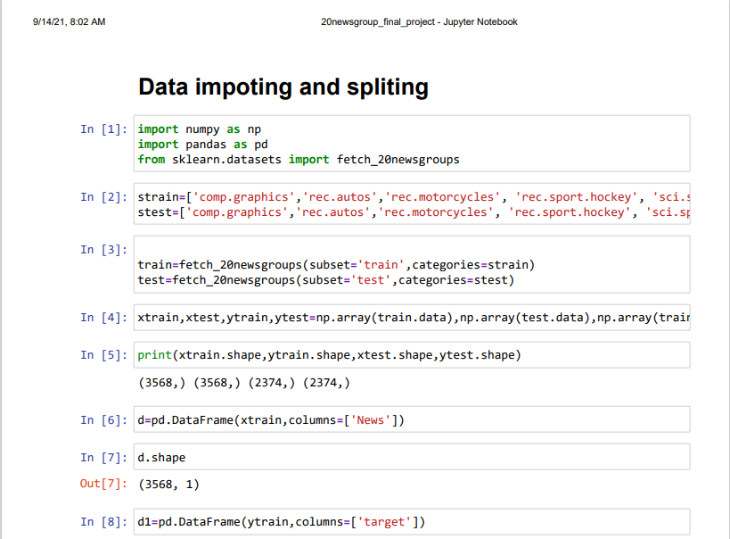
CODE of Project

Slide 10
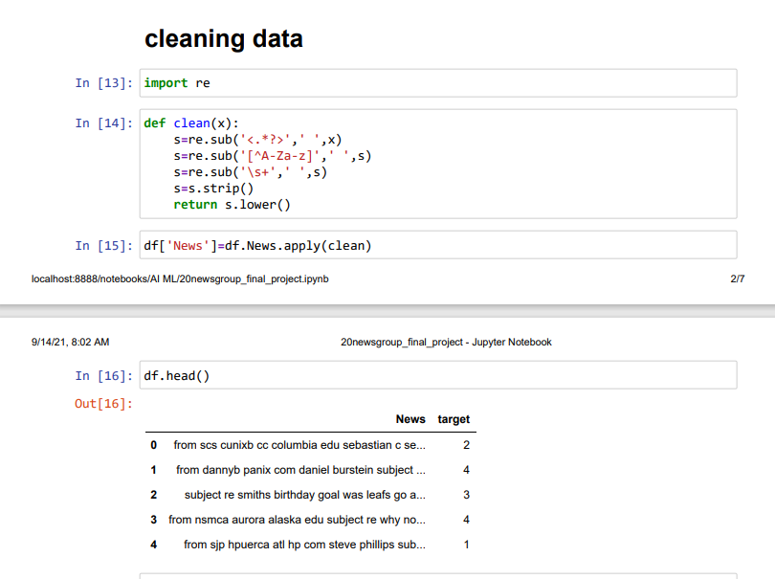
CODE of Project

Slide 11
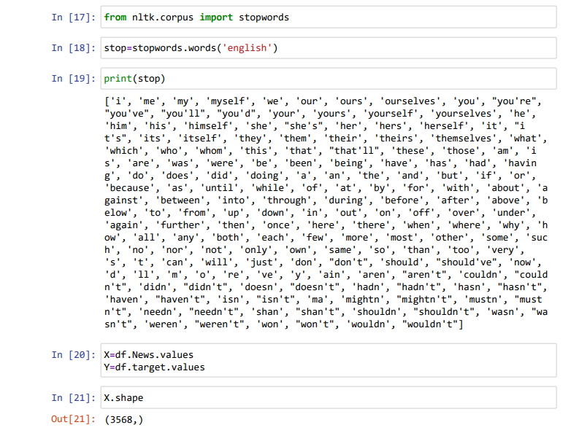
CODE of Project

Slide 12
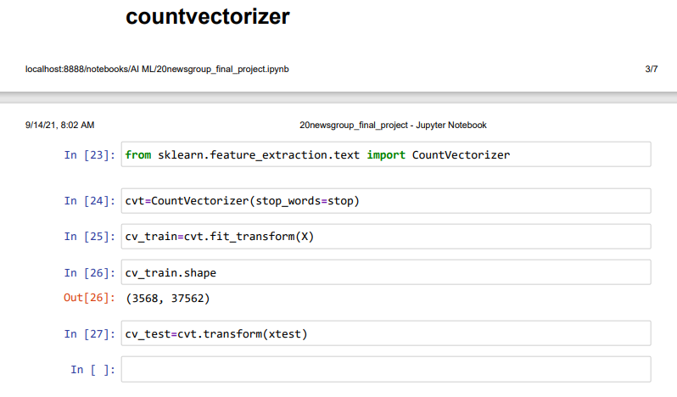
CODE of Project

Slide 13
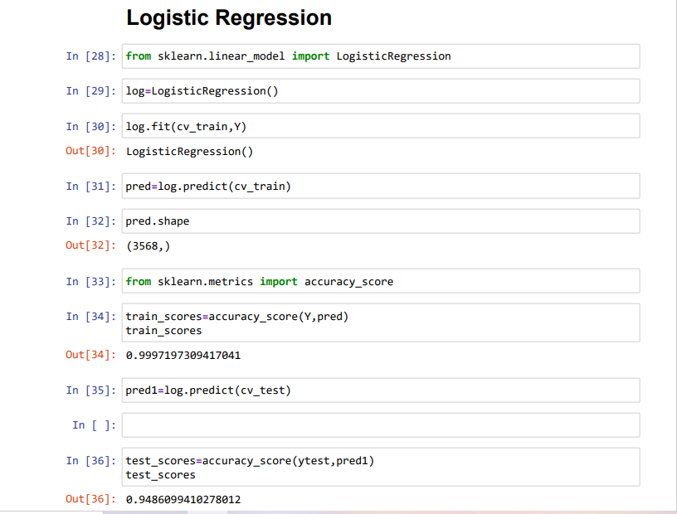
CODE of Project

Slide 14
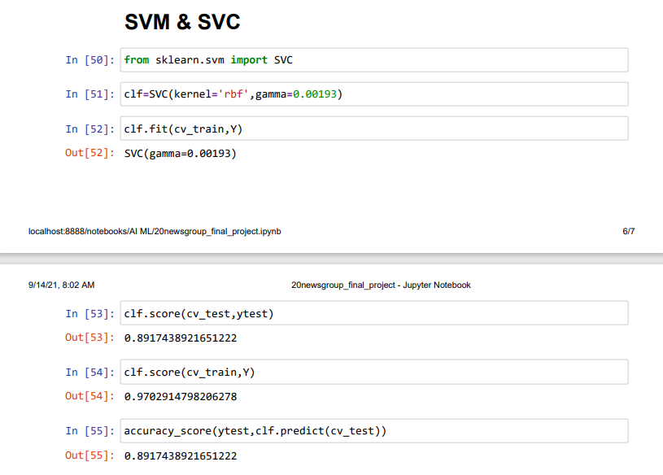
CODE of Project

Slide 15
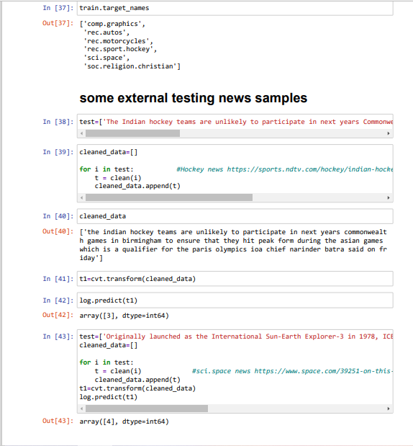
CODE of Project

Slide 16
Scoring of the model
Train Data Score
Using LogisticRegression
accuracy_score=0.9997197309417041
Test Data Score
Using LogisticRegression
accuracy_score=0.9486099410278012
Train Data Score
Using SVM
accuracy_score=0.9702914798206278
Test Data Score
Using SVM
accuracy_score=0.8917438921651222
So as conclusion our model is well trained by Logistic Regression algorithm and performing well on the train data as well as on the test data

Slide 17
Project Developer
Name : RISHABH SINGH
College : IET LUCKNOW
Branch : IT Year : 2nd(3rd sem)
Gmail: 2000520130047@ietlucknow.ac.in
Contact : 8273115387

Slide 18
References
https://www.ibm.com/in-en/cloud/learn/machine-learning
scikit-learn: machine learning in Python — scikit-learn 0.24.2 documentation
https://scikit-learn.org/stable/modules/generated/sklearn.linear_model.LogisticRegression.html
ML - Support Vector Machine(SVM) (tutorialspoint.com)
K-Nearest Neighbor(KNN) Algorithm for Machine Learning – Javatpoint
https://docs.python.org/3/library/re.html
AIML notes which are provided

Slide 19
THANK YOU

